Slide 1
Project 4
West Nile Virus Prediction
24 Sep 2022
Wei Hao
Connie
Ethan
Yonghe
Anand

Slide 2
Agenda
Contents | Presenter
Problem Statement & Background | Anand
Data Cleaning | Ethan
EDA | Ethan
Feature Engineering | Weihao
Modelling | Weihao/ Yonghe
Model Evaluation | Yonghe
Cost Benefit Analysis | Anand
Spray Analysis | Connie
Conclusion, Considerations & Recommendations | Connie

Slide 3
Problem Statement
In order to efficiently combat the West Nile Virus in Chicago we aim:
To build a model and make predictions that the city of Chicago can use about when and where when it decides to spray pesticides
To conduct a cost-benefit analysis that include annual cost projections for various levels of pesticide coverage (cost) and the effect of these various levels of pesticide coverage (benefit)

Slide 4
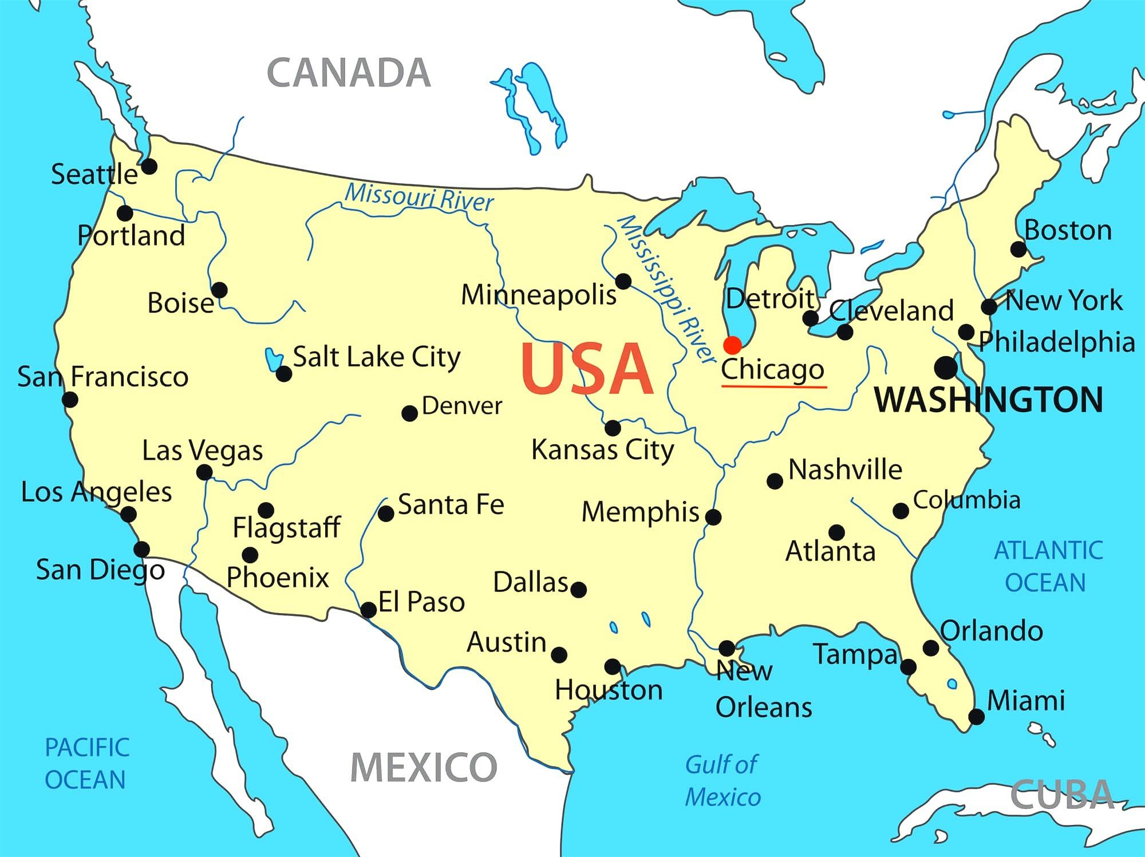

Background - About Chicago
City in the State of Illinois
Third latest city in the US
Home to 2.7 million residents
Land size about 600 km² (Singapore is about 728 km²)
Extensive parklands, including 30km² of city parks attract estimated 86 million visitors annually
Very passionate sports town

Slide 5
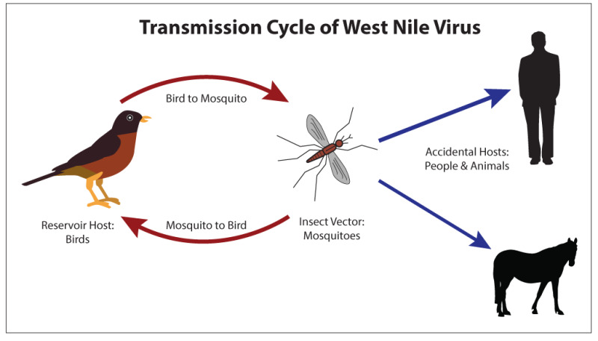
Background - West Nile Virus
What is the West Nile Virus?
Causes the West Nile Fever infection
80% of infections have no symptoms
20% of people develop a fever, headache, vomiting, or a rash
Transmission of Virus
West Nile Virus is found in birds
Birds transmit the virus to mosquitoes who then infect humans and animals

Slide 6
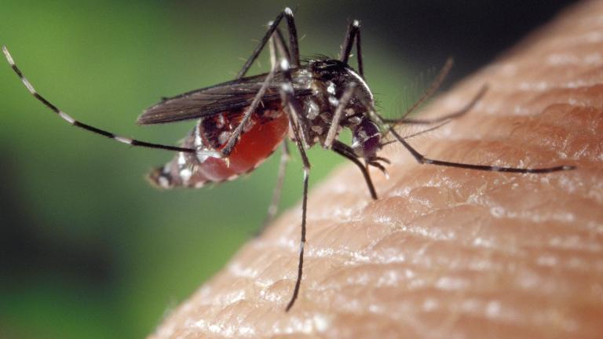
Background - WNV in Chicago
Chicago has one of the highest death rates of West Nile Virus in the US
Symptoms include: Headache and bodyache, joint pain, vomiting, diarrhea, etc
1 in 150 develop serious symptoms: Encephalitis, Meningitis
1 in 10 cases result in death
No vaccine is available

Slide 7
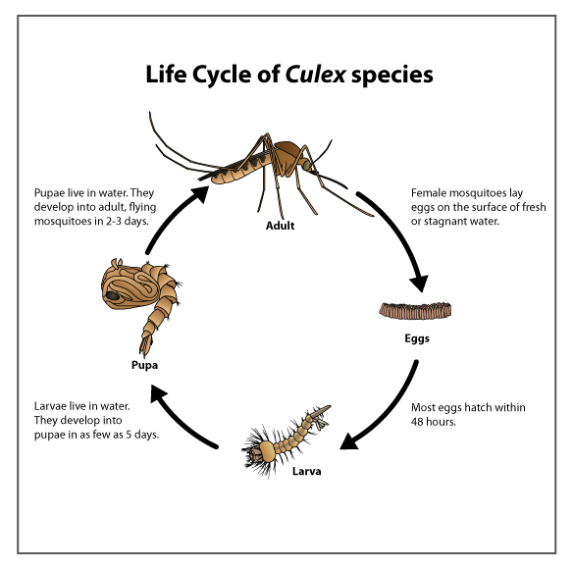
Background - Life cycle of Culex species
Eggs to larva within 48 hours
Larvae live in water, develop into pupae in 5 days
Pupae also live in water, develop into flying mosquito in 2-3 days
In total, about 7-10 days for an egg to develop into an adult mosquito
Information is crucial for determining the frequency on when to spray to prevent the spread of the West Nile Virus

Slide 8
Data Description
Years available for each Dataset
Dataset | 2007 | 2008 | 2009 | 2010 | 2011 | 2012 | 2013 | 2014 | Rows | Columns
Train | ✔ |  | ✔ |  | ✔ |  | ✔ |  | 10,506 | 12
Test |  | ✔ |  | ✔ |  | ✔ |  | ✔ | 116,293 | 11
Weather | ✔ | ✔ | ✔ | ✔ | ✔ | ✔ | ✔ | ✔ | 13,710 | 22
Spray |  |  |  |  | ✔ |  | ✔ |  | 2,944 | 4

Slide 9
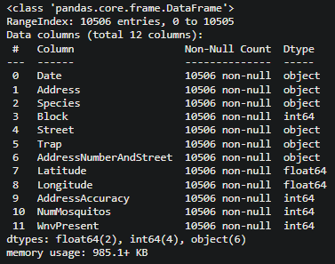
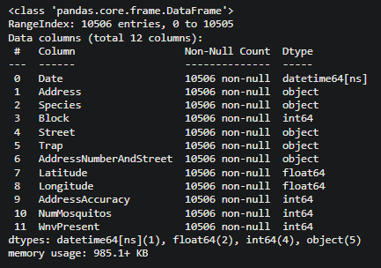
Data Cleaning - Train
Observations
No null values in all columns
Data Cleaning
Change “Date” data-type to datetime

Slide 10
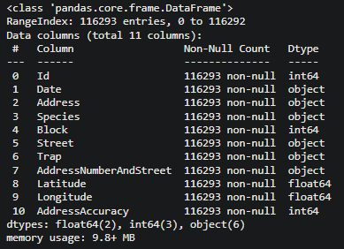
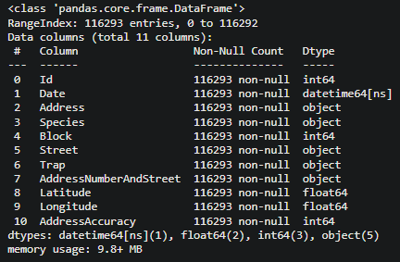
Data Cleaning - Test
Observations
No null values in all columns
Data Cleaning
Change “Date” data-type to datetime

Slide 11
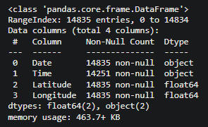
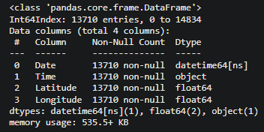
Data Cleaning - Spray data
Observations
584 null values in “Time” column
541 duplicated rows
All null and duplicate values happen on one single date 2011-09-07
Data Cleaning
Drop nulls
Drop duplicates
Change “Date” data-type to datetime

Slide 12
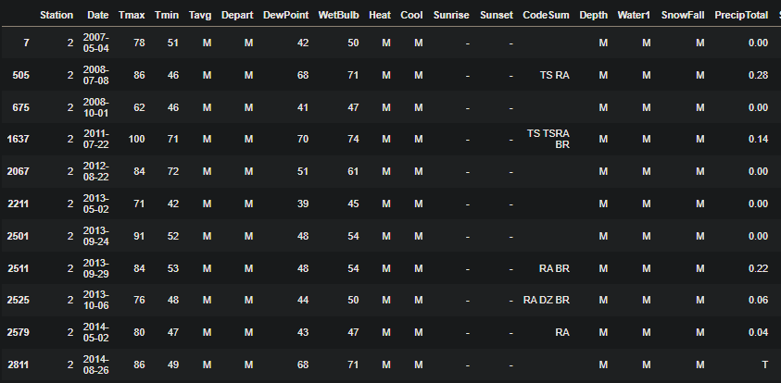
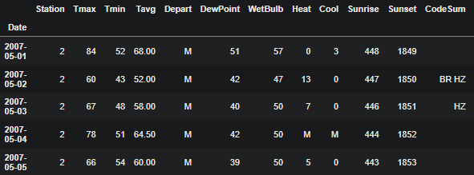
Data Cleaning - Weather data
Observations
No null values in all columns
Some non-numeric values in some columns (e.g. “M” in Tavg, “T” in PrecipTotal)
“-” in Sunset and Sunrise only for Station 2
Data Cleaning
Change “Date” data-type to datetime
When reasonably possible, change non-numeric to numeric data
Update Sunset and Sunrise times for Station 2 data

Slide 13
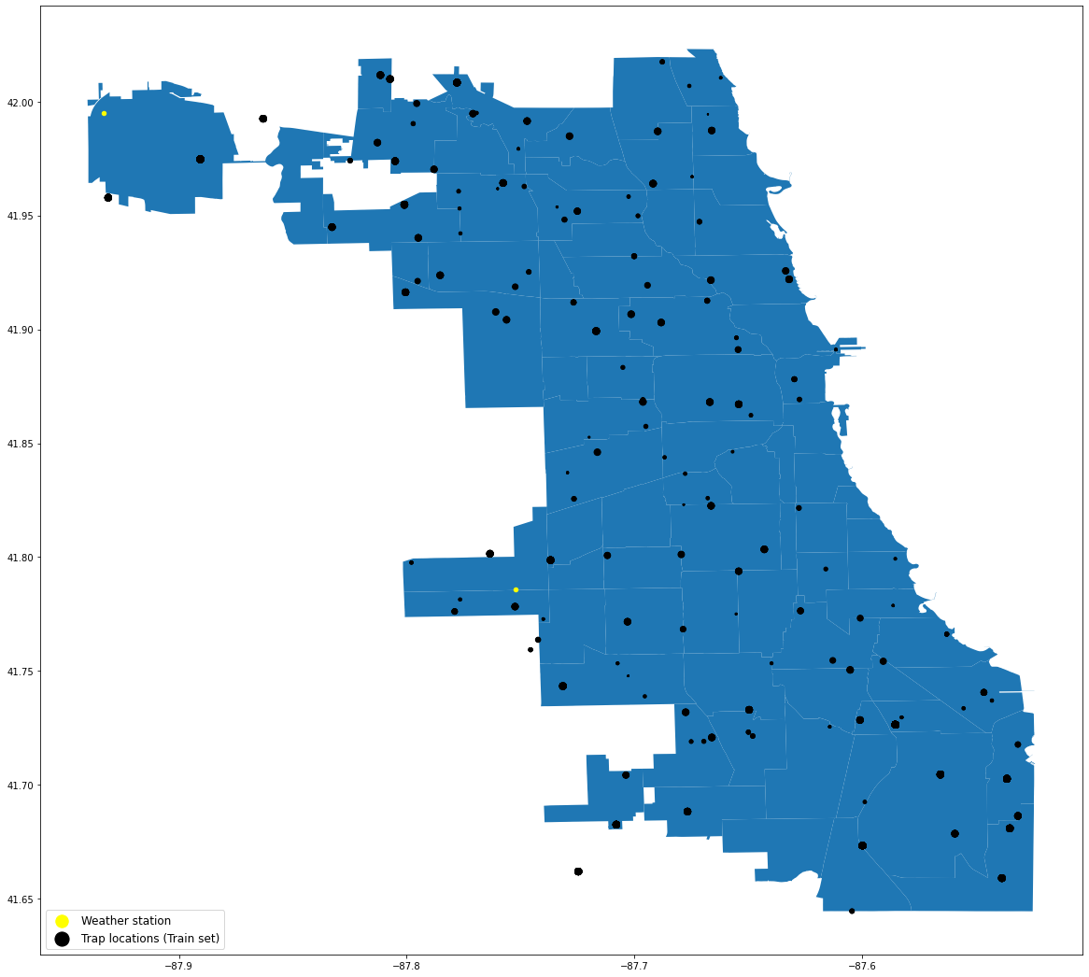
EDA - Trap Locations
1
136 trap locations are scattered across Chicago, represented by black dots
Size of black dots represents the number of mosquitoes caught
Weather stations are represented by yellow dots
Station 1: Chicago O’Hare International Airport
Station 2: Chicago Midway International Airport
2

Slide 14

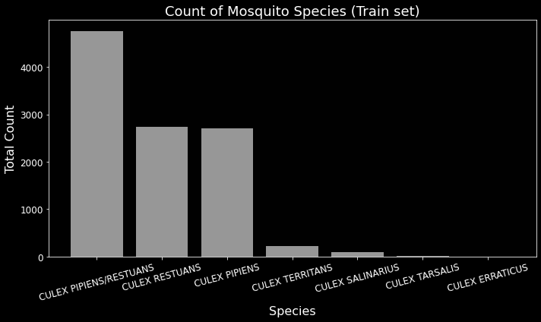
EDA - Mosquito Species
There are 7 unique species in the Train dataset
Only 3 species are found to spread the West Nile Virus
Culex Pipiens/Restuans
Culex Restuans
Culex Pipiens
The species that do not spread the virus have low counts in the Train set, but high counts in the Test set

Slide 15
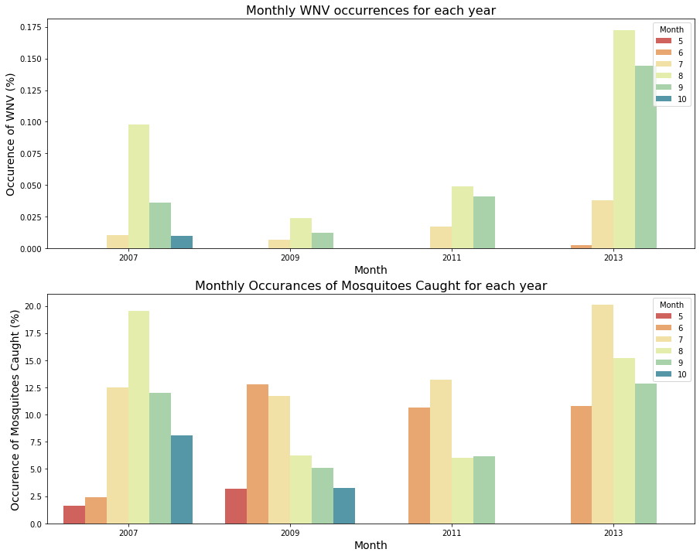
EDA - Seasonality Effects
WNV cases tend to see a sharp peak in August before dropping
The number of mosquitoes caught show a similar trend where there is a sharp peak before dropping
There is likely a time lag between mosquitoes caught and WNV cases
WNV cases coincides with the summer months of early June to end August

Slide 16
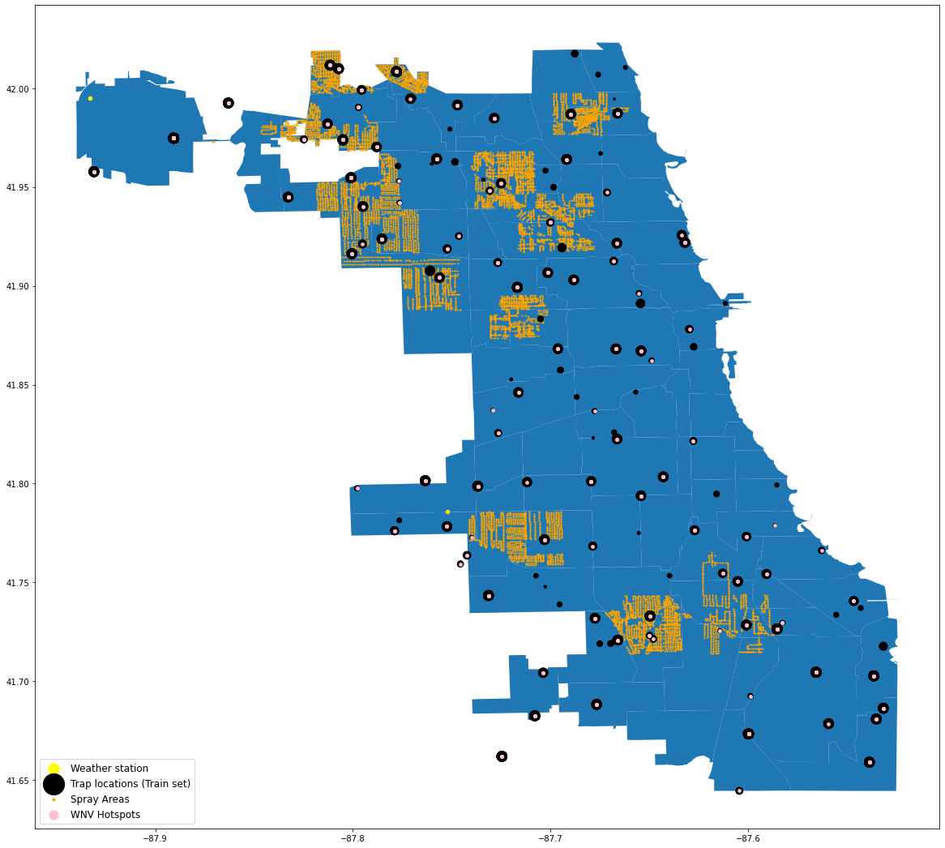
EDA - Spray Data
Pink dots represent locations where WNV cases are present (“hotspots”)
Black and pink dots tend to coincide
Orange areas show where spraying takes place - Not all hotspots or locations with mosquitoes are being sprayed
It is difficult to visualise the relationship now - we will focus on the spray effects at particular times later

Slide 17
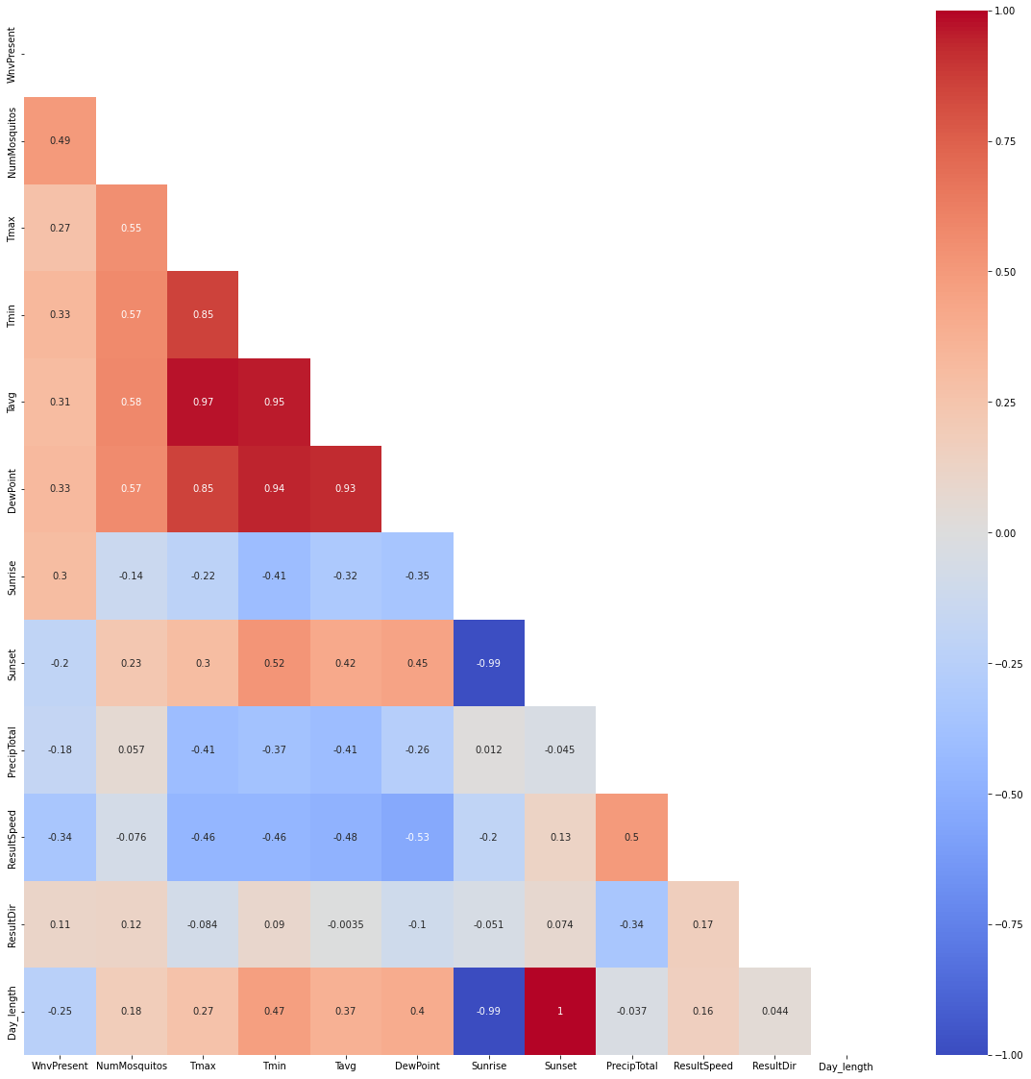
EDA - Weather Data
Correlation table with numeric data
Max, Min, Average Temperature
Dewpoint
Sunset and sunrise
Precipitation
Wind Speed (mph)
Wind Direction
Day length
Features with higher correlation:
Temperature and Dewpoint

Slide 18
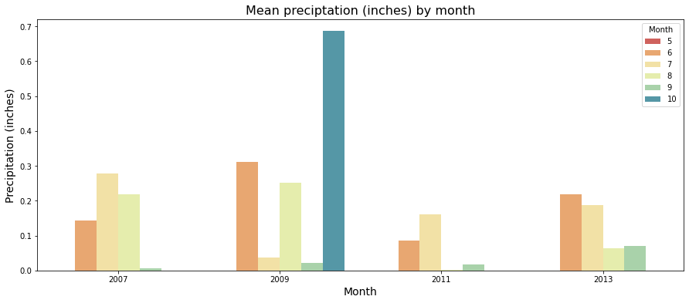
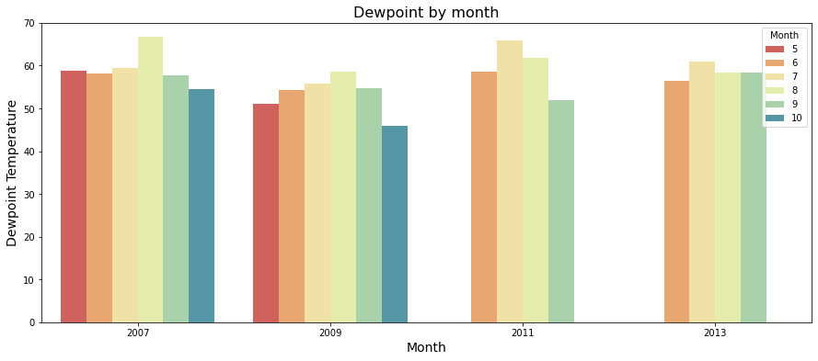
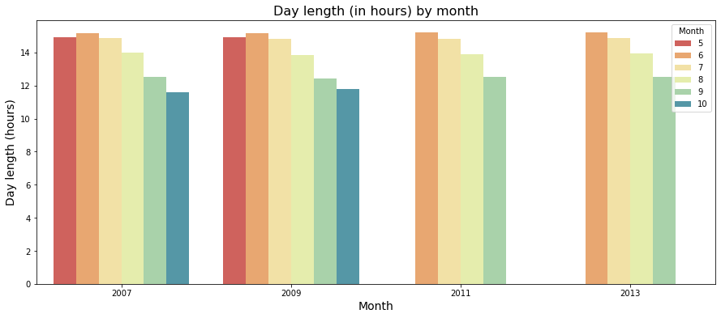
EDA - Selected Weather Data
Interesting observations:
Mean precipitation: Oct 2009 looks like an outlier as there is only one data point in that month
Dewpoint: Follows a similar seasonal trend to temperature as they are highly correlated
Day length: Calculated as part of Feature Engineering. Days get shorter after the summer months.

Slide 19
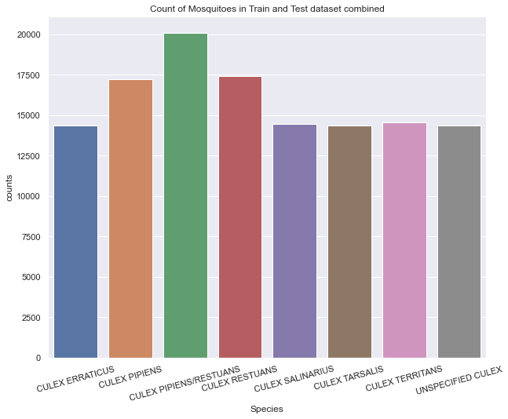
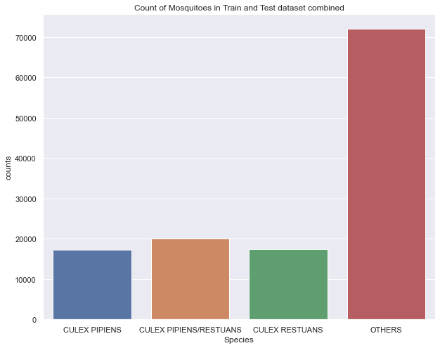
Feature Engineering
All other species which do not carry the West Nile Virus will be regrouped to 'OTHERS'

Slide 20
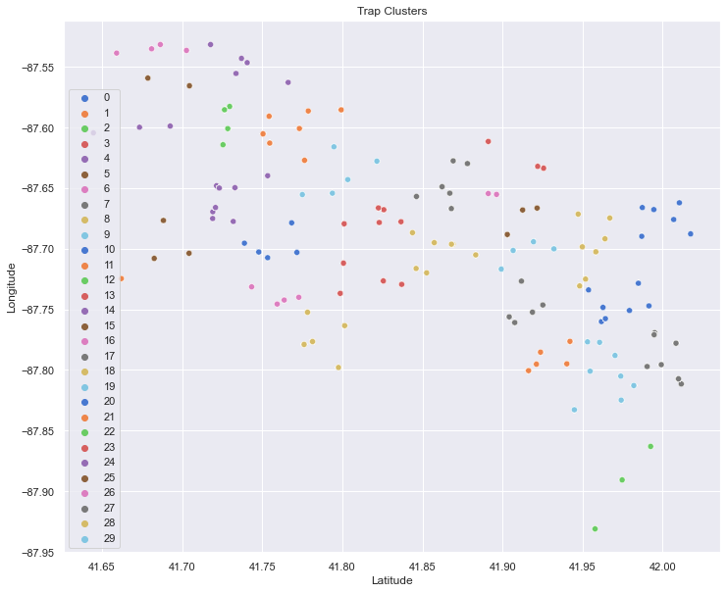
Feature Engineering
Trap locations are grouped together into 30 clusters using K Means clustering
These values are then dummified
Clustering was derived on Train data and subsequently used to predict clustering on Test
Example of a Trap Cluster

Slide 21
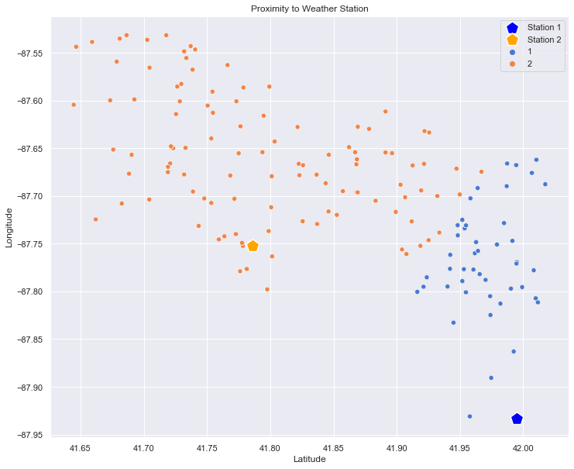
Feature Engineering
Traps are assigned to the nearest weather stations based on proximity
Weather recorded on the same day is different for both stations
Blue dots: Closer to Station 1
Orange dots: Closer to Station 2
Weather data are then assigned to each trap location
Closer to Station 2
Closer to Station 1

Slide 22
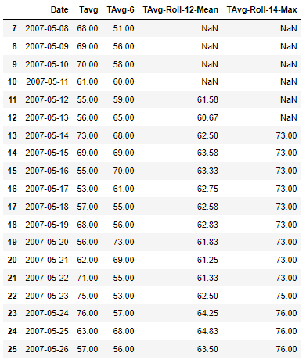
Feature Engineering
Weather features are further transformed with:
Shifting feature forward for period of 6 days
Looking back 12 days and taking the mean
Looking back 14 days and taking the max
Example is shown on the right for Transformation 1 & 2.
Max of 14 days
3
2
Add up past 12 values and find the mean
1
Shift 6 dates down

Slide 23
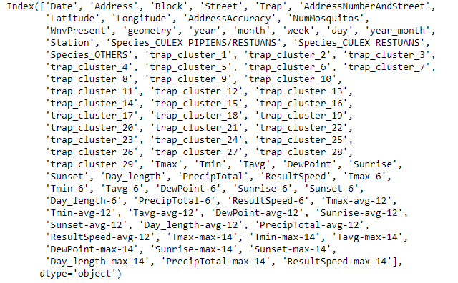
Feature Engineering
After Feature Engineering, dataset would have a total of 86 features, consisting of:
Time features (Date, year, month, week etc)
Location features (Address, Block, Street, Longitude, Latitude etc)
Mosquito Species (3 dummy variables)
30 trap clusters
9 weather features
27 (9x3) transformed weather features

Slide 24
Modelling
Handle Imbalance Data
Evaluation Metrics
Model Evaluation

Slide 25
Modelling - Handle Imbalance Data
Train Data
Processed Train Data to feed into models
WNV Present | Percentage
0 | 95%
1 | 5%
WNV Present | Percentage
0 | 67%
1 | 33%
Undersampling
Oversampling
WNV Present | Percentage
0 | 95%
1 | 5%
WNV Present | Percentage
0 | 67%
1 | 33%
SMOTE

Slide 26
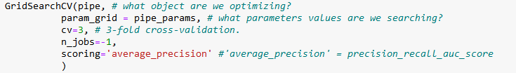
Modelling - Evaluation Metrics
Precision-Recall AUC Score:
Also known as the Average Precision Score, it is a way to summarize the Precision-Recall curve into a single value
Used when data is heavily imbalance and when you care more about the positive class
F1 Score
Harmonic mean of the precision and recall
Used when you care more about the positive class

Slide 27
Models
1 | DummyClassifier always predicting 'WnvPresent' to be 1
2 | OverSampling + UnderSampling + GradientBoost
3 | OverSampling + UnderSampling + RandomForest
4 | OverSampling + UnderSampling + LightGBM
5 | Smote + GradientBoost
6 | Smote + RandomForest
7 | Smote + LightGBM
For sake of time, we will only be covering Models 1, 2 & 7 in this presentation.

Slide 28
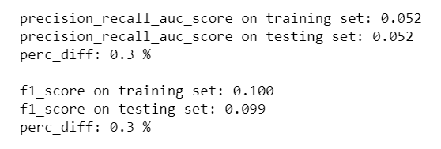
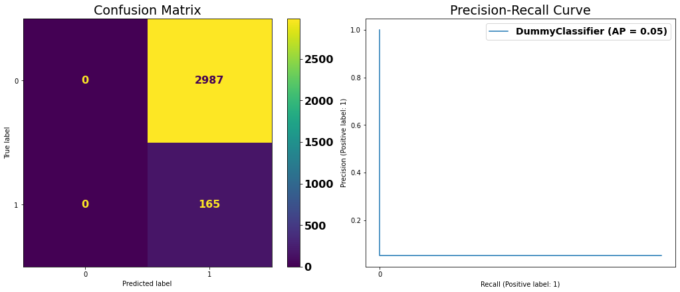
Model 1: Baseline Model
DummyClassifier always predicting 'WnvPresent' to be 1
Train Data
WNV Present | Percentage
0 | 95%
1 | 5%
0.05

Slide 29
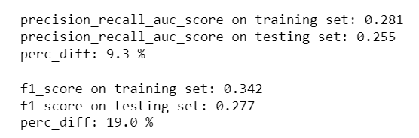
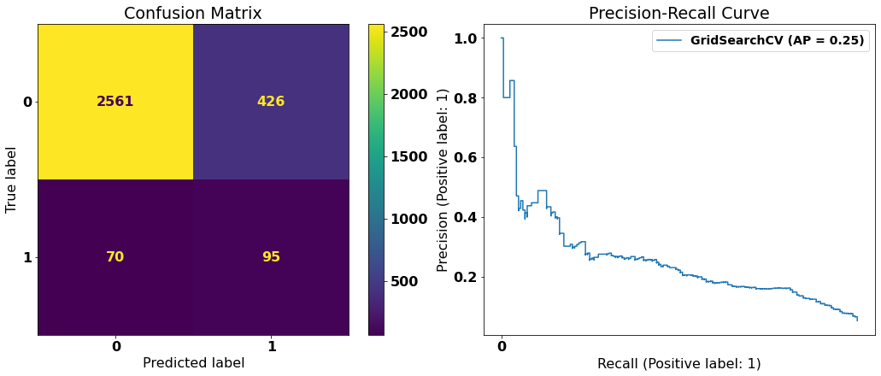
Model 2:
OverSampling + UnderSampling + GradientBoostingClassifier
( from 0.05 to 0.25 )
( from 0.09 to 0.27 )

Slide 30
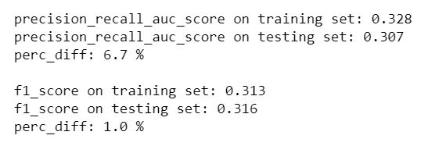
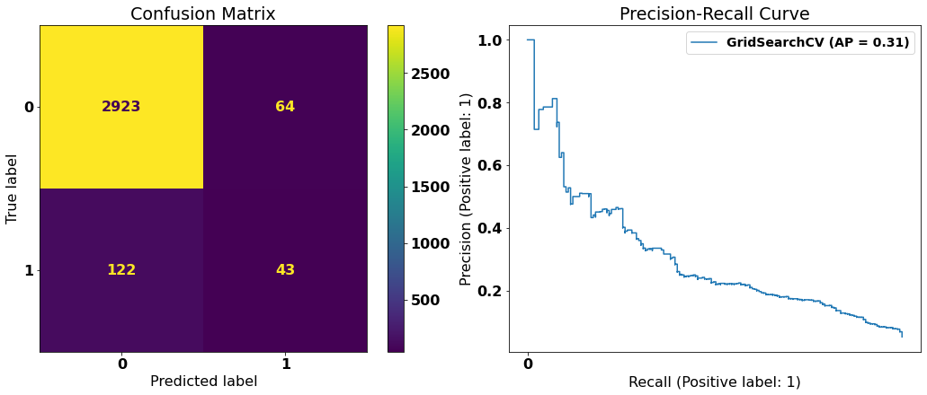
Model 7:
SMOTE + LGBMClassifier
( from 0.25 to 0.30 )
( from 0.27 to 0.31 )

Slide 31
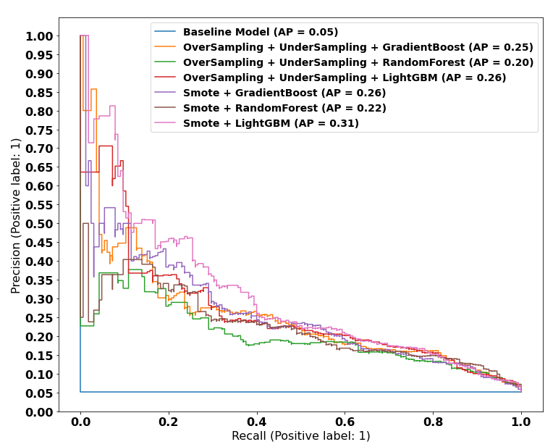
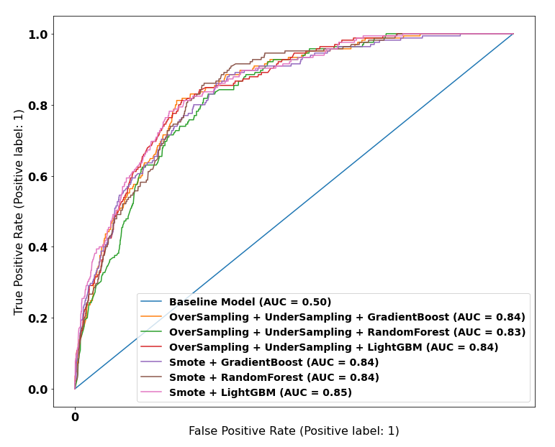
Model Evaluation
Precision-Recall Curve
ROC curve

Slide 32
Model Evaluation
Models | PR-AUC_Train | PR_Auc_Test | Generalization | F1_train | F1_test | Generalization
Baseline Model | 0.05 | 0.05 | 0.27 | 0.10 | 0.10 | 0.25
O/S + U/S + GradientBoost | 0.28 | 0.25 | 9.33 | 0.34 | 0.28 | 18.95
O/S + U/S + RandomForest | 0.21 | 0.20 | 4.59 | 0.17 | 0.16 | 5.62
O/S + U/S + LightGBM | 0.28 | 0.26 | 4.67 | 0.32 | 0.29 | 9.15
Smote + GradientBoost | 0.30 | 0.26 | 11.83 | 0.24 | 0.27 | 10.82
Smote + RandomForest | 0.24 | 0.22 | 6.71 | 0.24 | 0.24 | 0.77
Smote + LightGBM | 0.33 | 0.31 | 6.67 | 0.31 | 0.32 | 0.96
Production Model chosen for best score and generalization

Slide 33
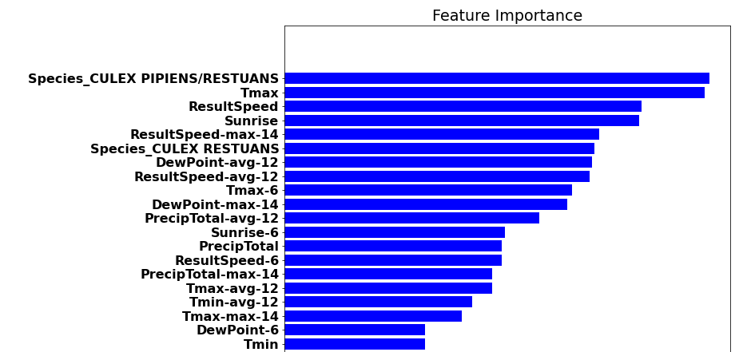
Feature Importance (Top 20)

Slide 34
Cost-Benefit Analysis
Inaccuracy Costs
Impact of False Positive indication of West Nile Virus | Impact of False Negative indication of West Nile Virus
Unnecessary Spraying Loss of Productivity of Civil Servants Causes disruption to daily life in affected communities Increased burden on taxpayers | Increased proliferation of West Nile Virus disease Increased strain on health care resources due to rise in cases Public Health reputational and political risk

Slide 35
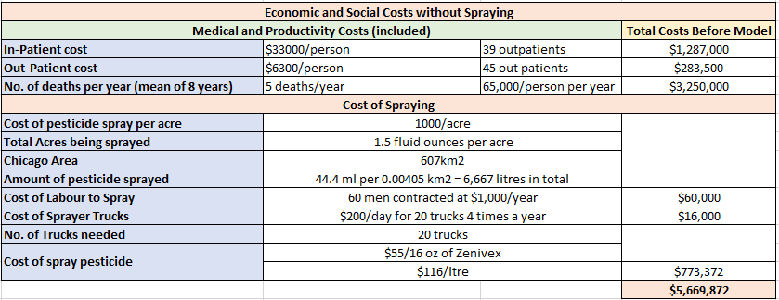
Cost-Benefit Analysis
The costs of spraying are a fraction of the Medical and Productivity costs (not to mention the lives lost), which makes the effort well worth the financial investment
Usage of our model would assist in a more target usage of pesticide spray which could also further reduce costs
Money saved for the taxpayer could engender more fiscal confidence in public health system

Slide 36
Negative Externalities due to WNV
Work absenteeism
Public health impact and cost
Government and Public Health Officials reputational loss
Impact to families (financial burden, caregiver costs for most vulnerable, etc.)
Decreased tourism
Increased death risk amongst population might incur public outrage
Recommend to :
SPRAY

Slide 37
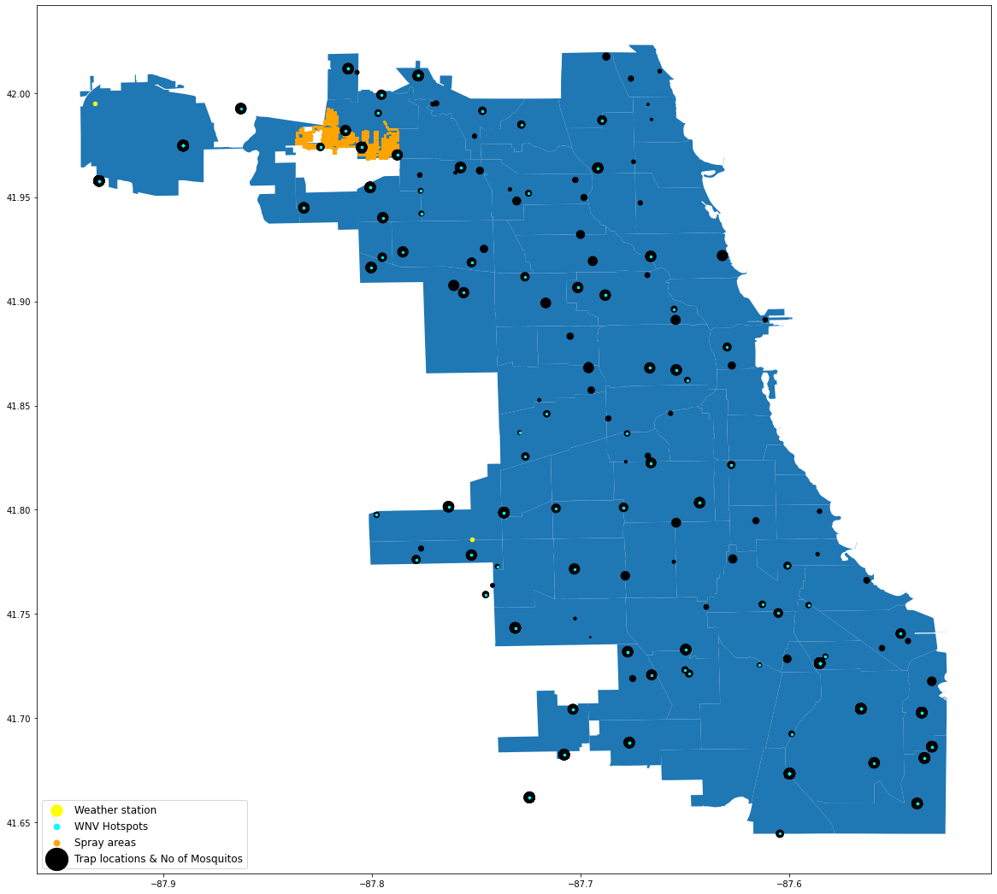
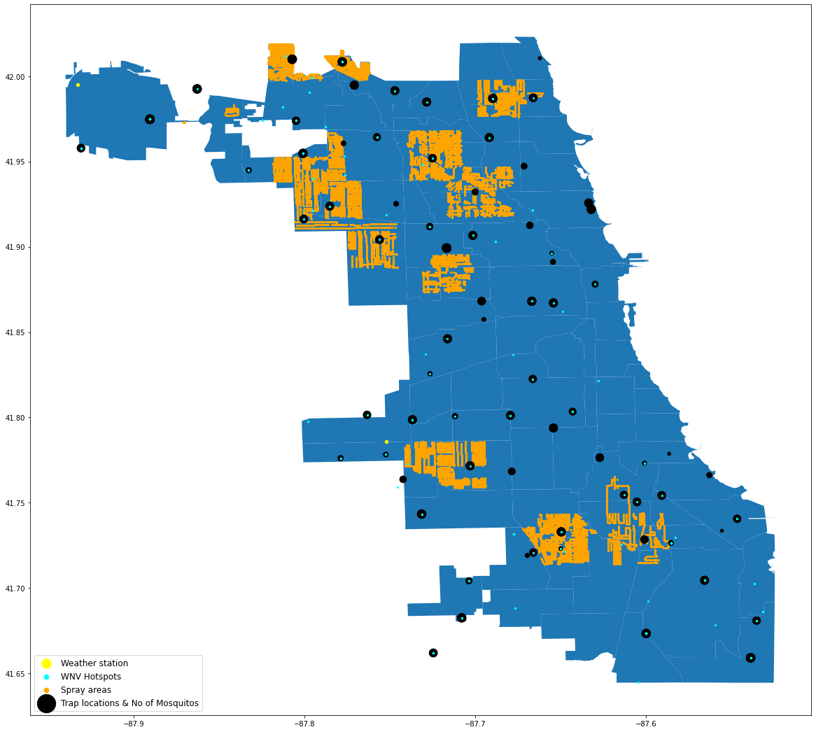
Spray Data Analysis
There are a total of 9 spray dates in dataset, 1 in 2011 and 8 in 2013.
Spraying is done indiscriminately, regardless of whether there is a WNV hotspot or not.
2011
2013

Slide 38
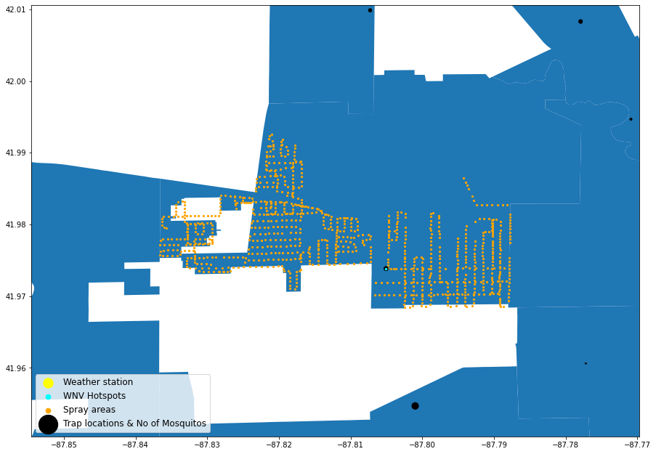

Spray Data Analysis - 7 Sep 2011
To test the effectiveness of the spray, we look at number of mosquitoes two weeks before and after spray (based on life cycle of a mosquito).
1 WNV Hotspot
0 left
2 weeks before
2 weeks after

Slide 39
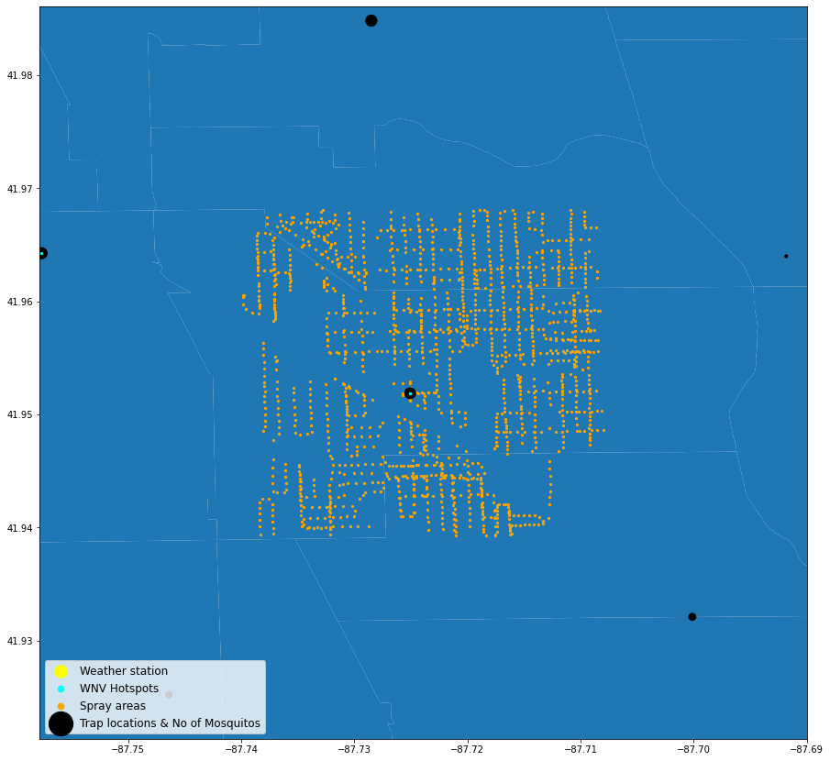

Spray Data Analysis - 25 Jul 2013
1 WNV Hotspot
0 left
2 weeks before
2 weeks after

Slide 40
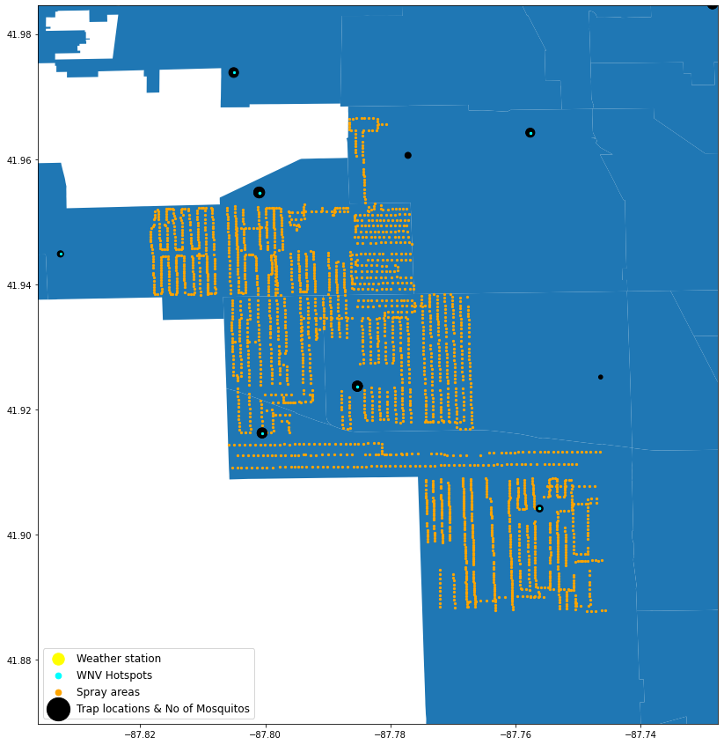

Spray Data Analysis - 15 Aug 2013
Not as effective
4 WNV Hotspot
4 left
2 weeks before
2 weeks after

Slide 41
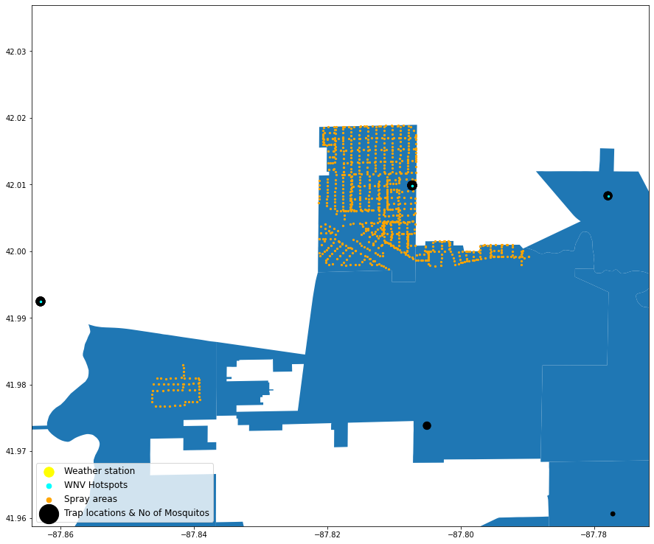

Spray Data Analysis - 5 Sep 2013
Not as effective
1 WNV Hotspot
1 left
2 weeks before
2 weeks after

Slide 42
Spray Data Analysis - Findings
Spraying done in an ad-hoc manner
Data from 2011 and 2013 seems to suggest that it was done without prior research
For e.g. in 16 Aug and 22 Aug 2013, spraying was not done on WNV hotspot areas or areas where trap locations are found
Spray not effective with time
Number of mosquitoes did not drop within spraying area.
Effectiveness of spraying seemed to reduce later on in the months, perhaps due to mosquitoes developing resistance to pesticides over time
Spraying not effective in curbing virus
WNV hotspots still remain 2 weeks after spraying
Assuming adulticide sprays are applied, which only kills adult mosquitoes, it is not truly effective in reducing virus as mosquito larvae is still alive

Slide 43
Conclusions, Considerations and Recommendations
WNV is more prevalent under certain conditions:
Longer daylight hours
Higher average temperatures
Spraying efforts should be focused during June to early July
Current spraying efforts are ineffective
Suggest to spray in early June to July, considering the gestation period of mosquitoes resulting in peak WNV cases in August
Health issues related to spray chemicals
Pregnant women and children have a greater risk of getting sick from pesticides
Consider different methods / alternatives to spraying
Consider larviciding catch basins, which involves dropping tablets in storm drains along the public roads which will slowly dissolve over a five-month period to prevent mosquito larvae from hatching
Eliminating standing water by ensuring that swimming pools and construction sites are regularly maintained

Slide 44
Q & A

Slide 45
Redundant Slides Below.. Please delete during finalisation

Slide 46
Recommendations (taken from other notebooks)
Understanding how WNV is transmitted by mosquitoes, including behaviour and habitat
Consolidated mosquitoes spray effort. Regular pre-spray to be done whether WNV present or not
Anti-mosquito education - How to prevent breeding
Start spraying from start of July to end of August, where avg temp are higher, weekly frequency, around locations where Culex Pipiens and Restuans are found
Use fish to eat mosquitoes?

Slide 47
Sources
It has become the leading cause of mosquito-borne disease and a key public health challenge in the United States. Around 80% of those infected typically display few or no symptoms. About 20% of infected people develop a fever, vomiting, or a rash. In the remaining less than 1% of those infected suffer from neuroinvasive disease (e.g encephalitis or meningitis). The mortality rate among those who suffer from neuroinvasive disease is estimated to be 10% https://www.cdc.gov/westnile/index.html
From 1999 to 2012, it is estimated that a cumulative of 778 million USD in health care expenditures and lost productivity were incurred from hospitalized cases https://www.ajtmh.org/view/journals/tpmd/90/3/article-p402.xml
Some info on Chicago fogging and spraying https://www.chicago.gov/content/dam/city/depts/cdph/Mosquito-Borne-Diseases/Zenivex.pdf
How weather affects mosquitoes https://blog.mosquito.buzz/how-weather-affects-mosquito-activity
Some stats https://www.cdc.gov/mmwr/preview/mmwrhtml/ss5902a1.htm
Population density https://www.newgeography.com/content/007491-chicagos-density-2020

Slide 48
Cost benefit analysis
https://www.ajtmh.org/view/journals/tpmd/90/3/article-p402.xml
(Have not read yet but there are some health care costs figures here)
Cost - total expenditure associated with spraying pesticide on adult mosquitoes/ eggs incurred in a year
Benefit - cost avoidance or savings from healthcare costs and productivity loss
Got python notebook on Cost benefit! (https://github.com/Zoeychengg/project_4/blob/master/codes/Cost%20Benefit%20Analysis%20Model.ipynb)
https://www.cdc.gov/mosquitoes/mosquito-control/community/truck-spraying.html

Slide 49
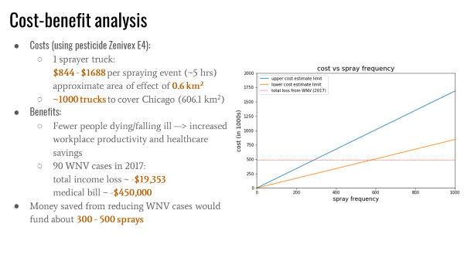
Cost benefit analysis

Slide 50
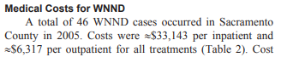
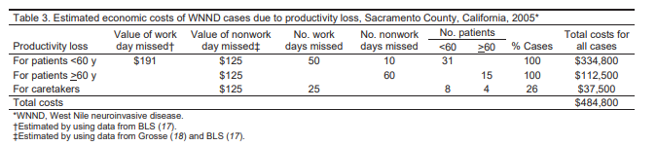
Cost of West nile
https://www.homeadvisor.com/cost/environmental-safety/mosquito-control/

Slide 51
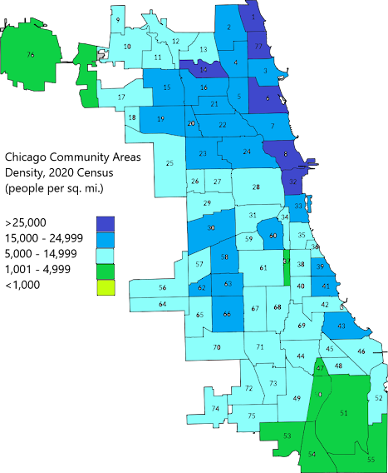
Population density

Slide 52
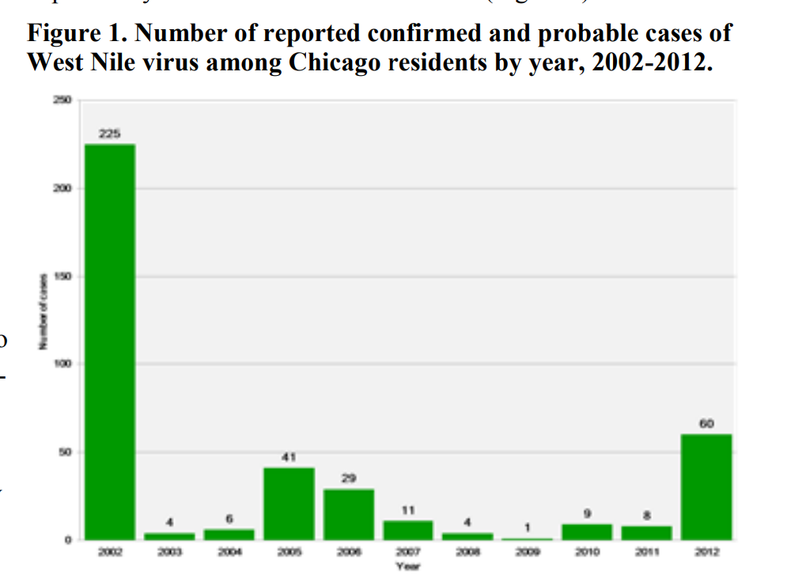

Slide 53
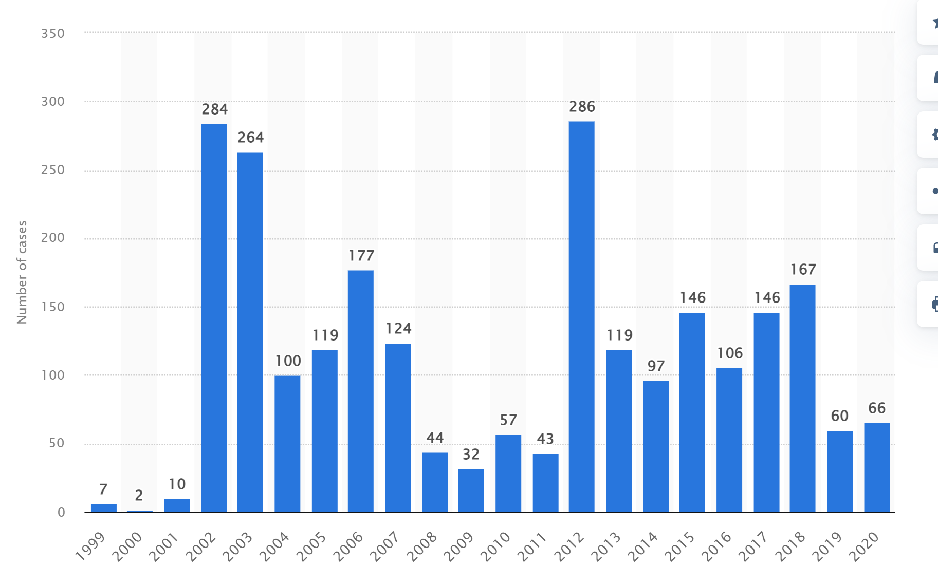
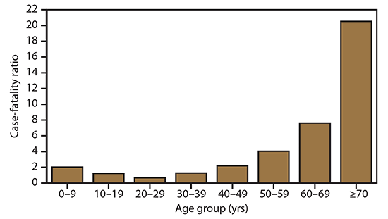
West Nile Virus has a low death rate and elders are more susceptible to the virus
Number of West Nile virus disease deaths in the US from 1999 to 2020
West Nile virus neuroinvasive disease case-fatality ratios, by age group — United States, 2009–2018
Source : statista.com
Source : cdc.gov

Slide 54

GDP Per Capita
https://www.statista.com/statistics/248112/per-capita-us-real-gross-domestic-product-gdp-by-metro-area/

Slide 55


Focus on spraying near higher population with elders to reduce fatality rate?
Source : Kaggle

Slide 56

Exploratory Data Analysis

Slide 57




Exploratory Data Analysis
TMax
Dew Point
Weather Data
Seasonality is observed
Wind speed
Wind Direction

